Slide 1

Frugal Fabrications
Charlie Roder, Andrew Roberts, Paul Pollard, Sylvain Garin-Michaud

Slide 2
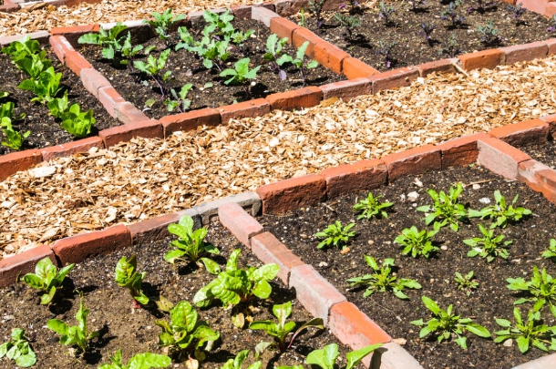
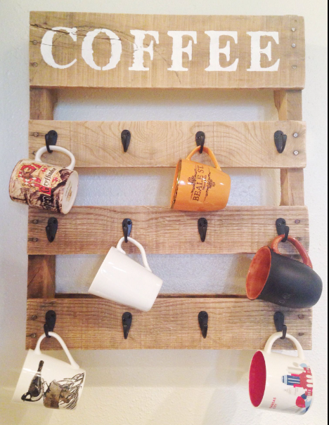
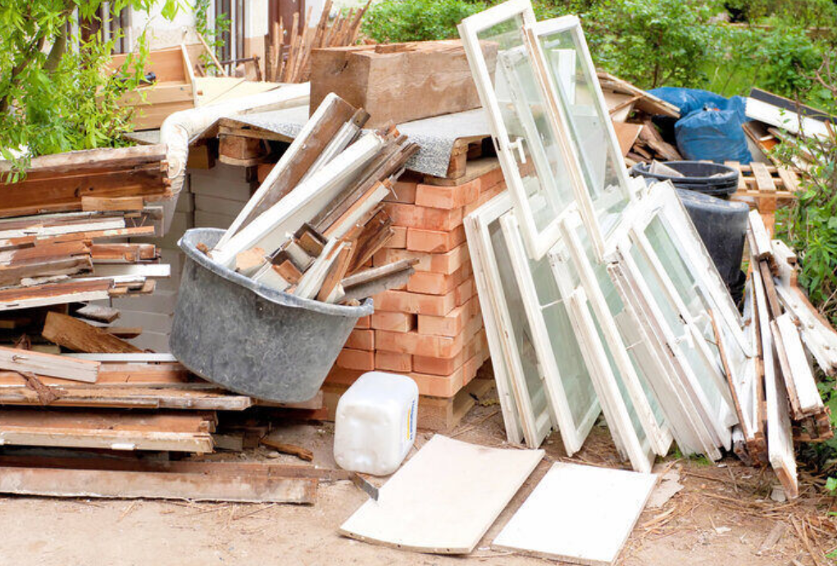
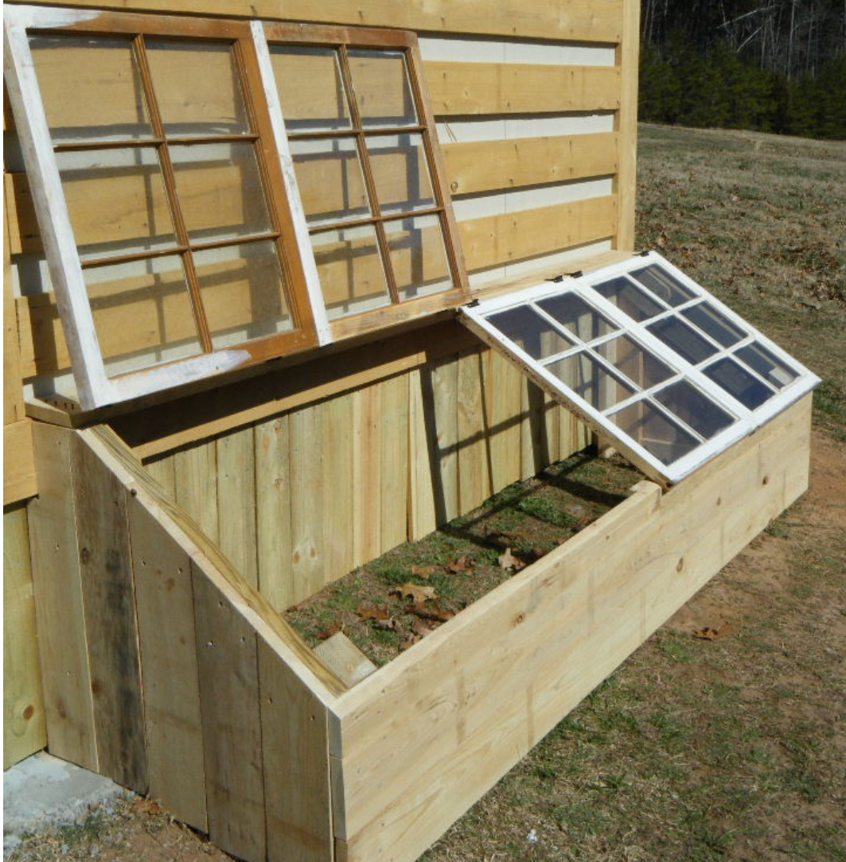
Application Overview
garden bed
mug holder
Leftover materials and junk
covered compost box

Slide 3
Project Requirements
Tool Implementation Requirement:
Employ an AI platform to give project ideas/instructions given a materials list
Profile Management Requirements:
Create/login/edit profile
User to User Interaction Requirements:
Marketplace for buying/selling projects
Browse and interact with other user's projects
Communicate with contractors

Slide 4
Project Requirements Continued
User to Application Requirements:
Use AI tool to browse project ideas and access project instructions
Post completed projects
Admin Requirements:
Overview of all social media activity
Certifying contractors
Editing profile pages
Security Requirements:
Securing user info and payment info (outsource)

Slide 5
Questions?

